Slide 1
Business Golf Club
(BGC)

Slide 2
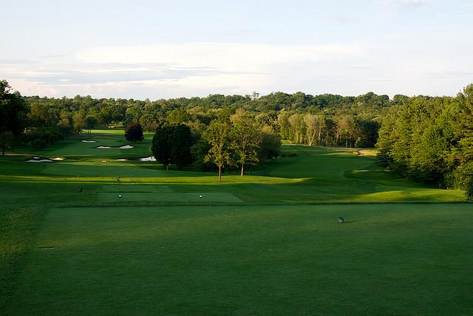
Executive Board
President: John Donnelly
Vice President: Chris Connolly
Treasurer: Henry Glucksman
Secretary: Max Berman
Communications Chair:
Ben Brod
Advisor: Bill Ryan

Slide 3
Our Objectives:
Connect Like-Minded Students
Learn how to leverage golf and business
Holistic approach in all areas of studies
Improve informal/formal communication skills

Slide 4
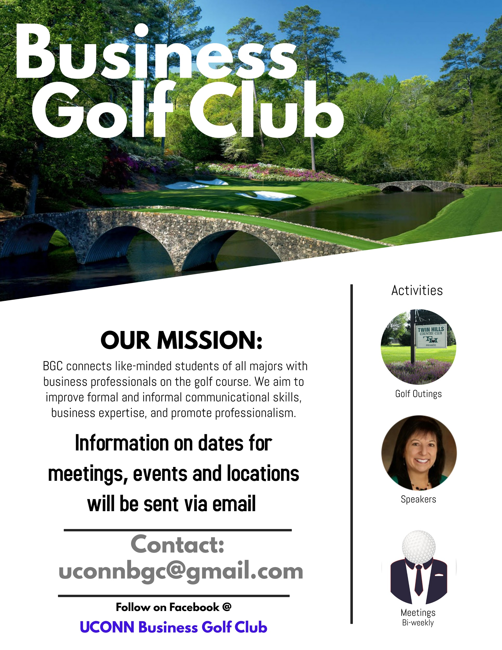
Benefits of Membership
Access to local golf courses for discounted prices $$
Eligible for golf outings with business professionals
Access to presentations given by our speakers
Our connections are your connections

Slide 5
Golf Weather
Warmer Months:
2-3 Practice Rounds
Local courses-pending cheapest pricing
1 Golf Outing w/ Business Professionals
1-2 Driving range sessions

Slide 6
Tips for Doing Business on the Golf Course
The Art of the Deal: Business Golf Tips

Slide 7
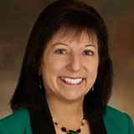
Colder month activities
Speakers/Workshops
Presenters include:
Pepsico VP of consumer strategies and insights
Cryptocurrency consultants
Northeastern University graduate program
Insurance associates
Treasury group representatives
Gain knowledge in all areas of study

Slide 8
Incentives to Come to Meetings
First come first serve for Golf Outings when limited spots are available
Opportunities for Executive Leadership positions
Opportunity to network with guest speakers

Slide 9
FUNDRAISING
Dues only for those interested in attending outings
Student Government Funding- next semester
Apparel Sales: w/ “Business Golf Head” as Logo
Alumni Outing w/ Sponsor and Networking Lunch

